Slide 1
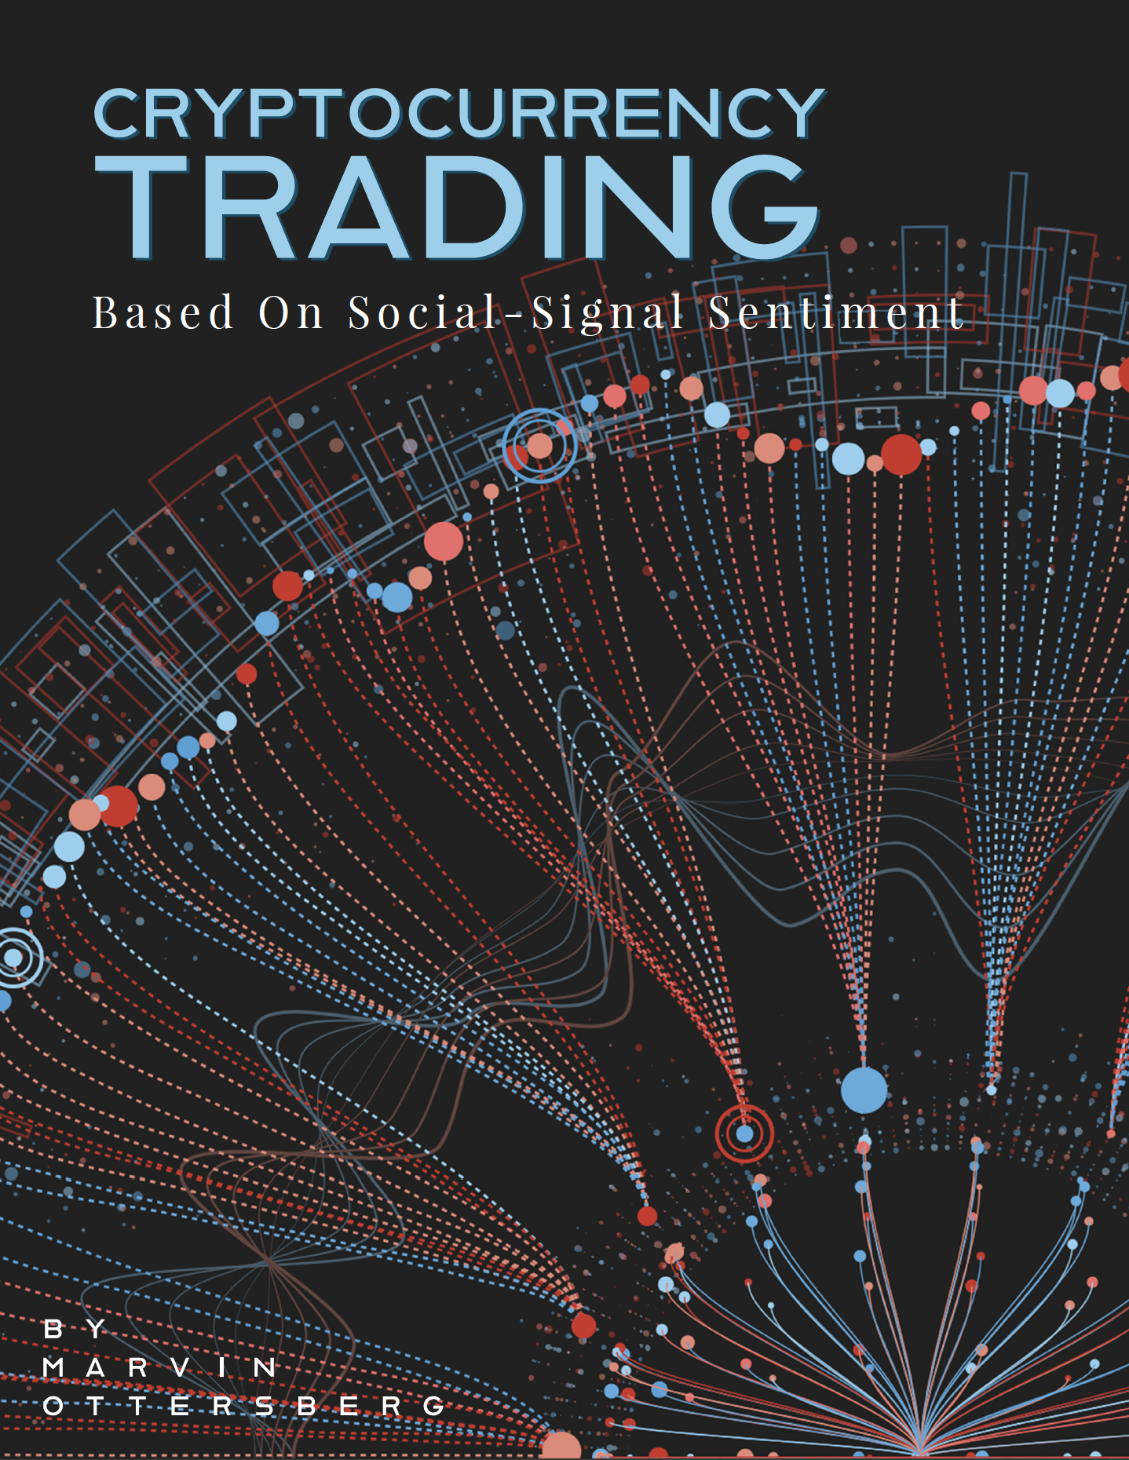
Exploring the connection between the sentiment on a social-media platform about a cryptocurrency and the correlating price.
Projektarbeit 2

Slide 2
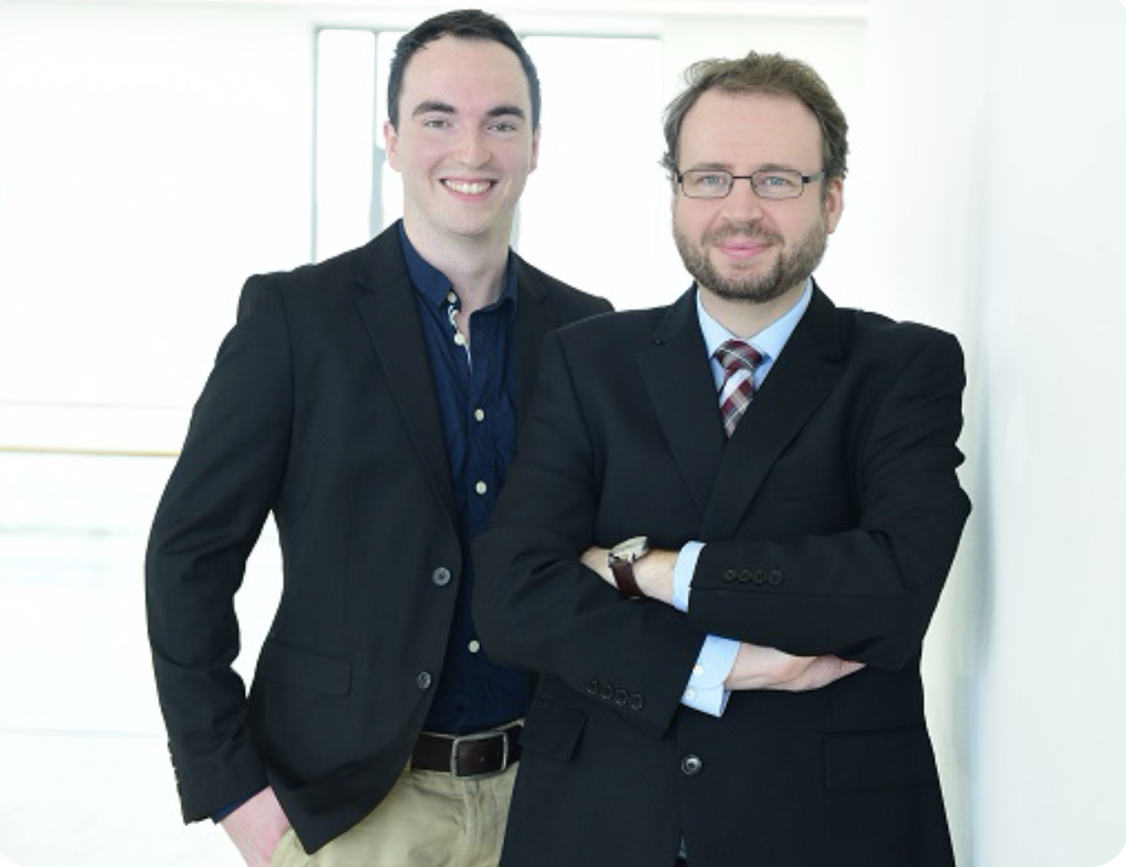

Context
“Chainsulting is a consulting and development company, on the subject of Distributed Ledger Technology (DLT) & Digital Assets. We show ways, opportunities, risks and offer comprehensive solutions.”
CEOS: Yannik Heinze & Florian Protschka

Slide 3
Approach
1. Research
2. Development
3. Testing & Documentation

Slide 4
Research
Cryptocurrencies
Social Media Platform and Relevance
Programming Language

Slide 5
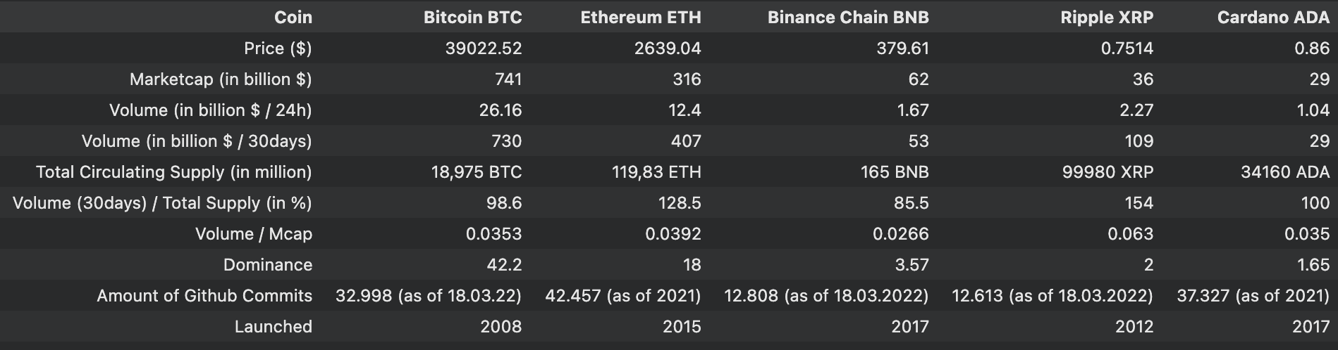
Top 5 Coins by MCap

Slide 6
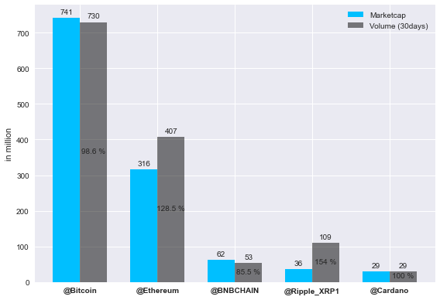
Mcap & Trading Volume

Slide 7




Social Media Platforms

Slide 8
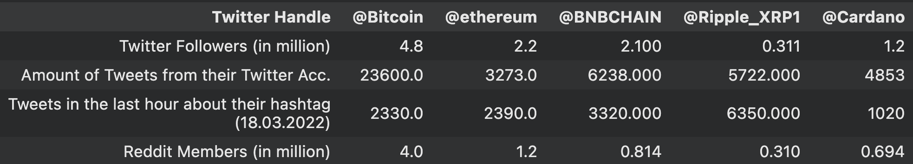
Coins on Twitter & Reddit

Slide 9

Programming Language
Experience with Python
Best for Data Analysis
Pandas
Visualisation
Matplotlib
Streamlit
Libraries for Brokers

Slide 10
Development Phase
Must-Have Requirements
The system delivers real-time tweets from Twitter
The system delivers a sentiment for each tweet
The system builds trade-signals based on sentiment
The system trades based on these signals
Should-Have Requirements
The system filters tweets
The system visualises metrics of tweets, sentiment and trades
The system stores the data in a database
The system can run in the background
NFR
The project must contain research on used cryptocurrencies and social-media platform
The project will be published open-sourced on GitHub

Slide 11
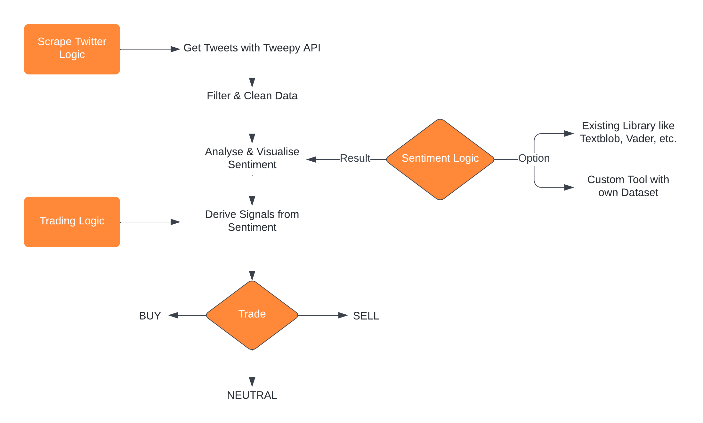
Dev Concept

Slide 12
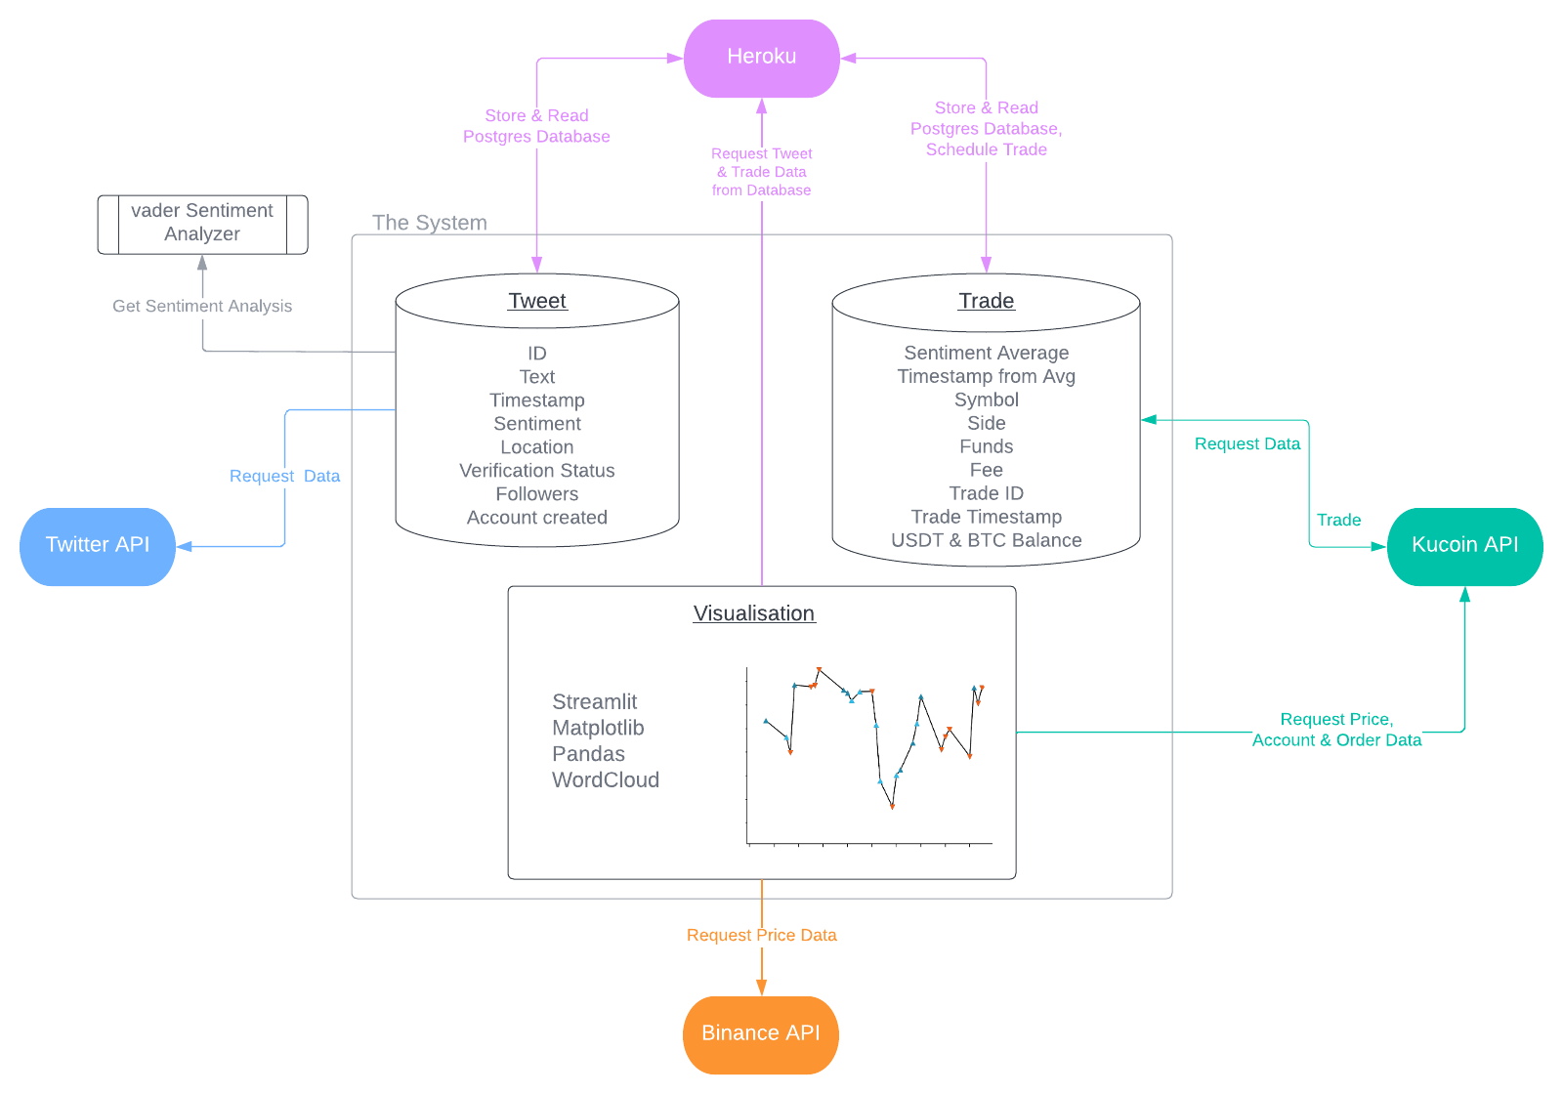
Architecture

Slide 13
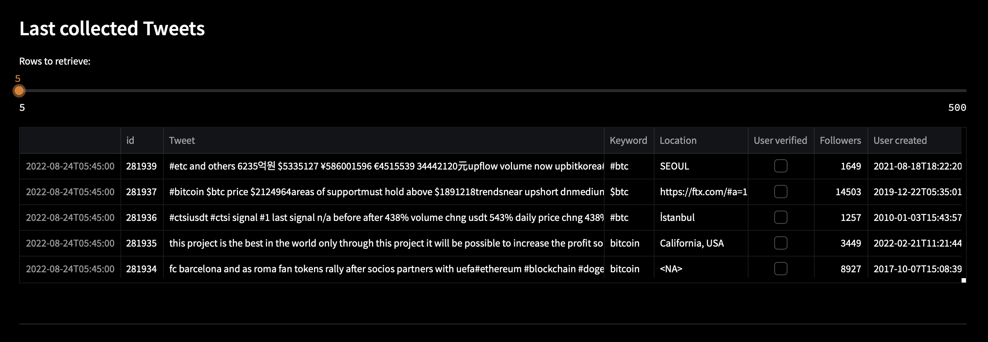
Data Acquisition with Tweepy

Slide 14
Filter
Before
“boii &amp people think is high now wait till itʼs $20k + by the end of this week $50k+ by end of 734982 this
month yʼall should follow he's a super underrated !bitcoiner iʼve been :following her tweets and tips seriously
iʼve been doing really great! #btc #ada"
After
"boii people think is high now wait till itʼs $20k by the end of this week $50k by end of this month yʼall should
follow hes a super underrated bitcoiner iʼve been following her tweets and tips seriously iʼve been doing really
great"

Slide 15
NLP with vader Sentiment
from vaderSentiment.vaderSentiment import SentimentIntensityAnalyzer
text = ”Just came across this pretty good CNBC piece on SpaceX & Starship"
vader = SentimentIntensityAnalyzer().polarity_scores(text).get("compound")
print(f"Vader: {vader}")
Vader: 0.7684

Slide 16
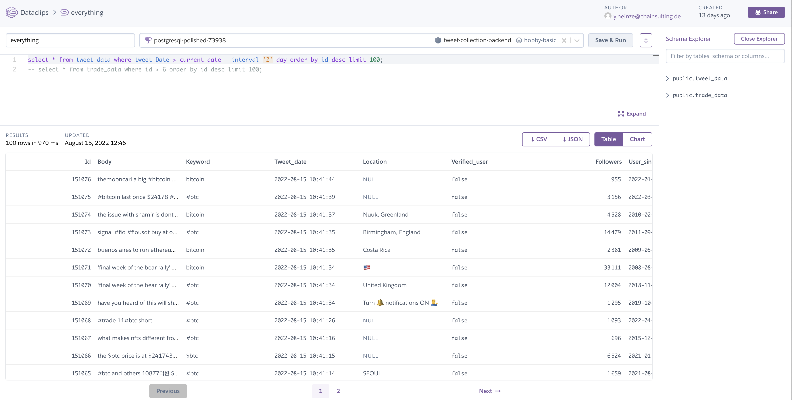
Database
Heroku runs script
in the background

Slide 17
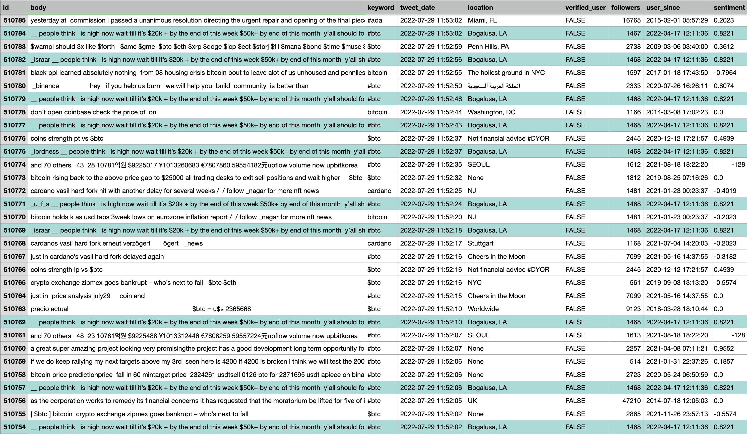
Duplicates

Slide 18
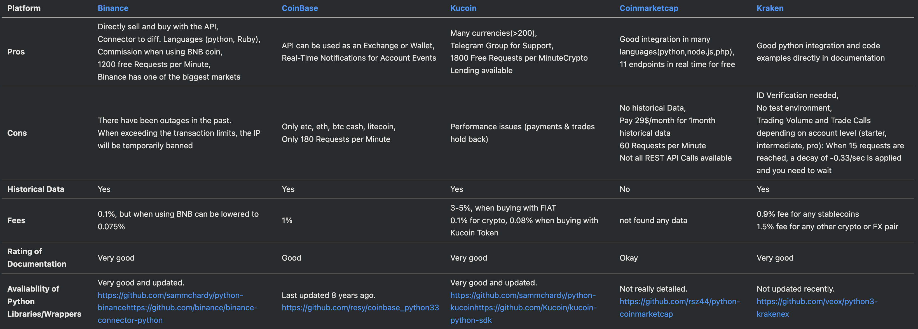
Trading

Slide 19
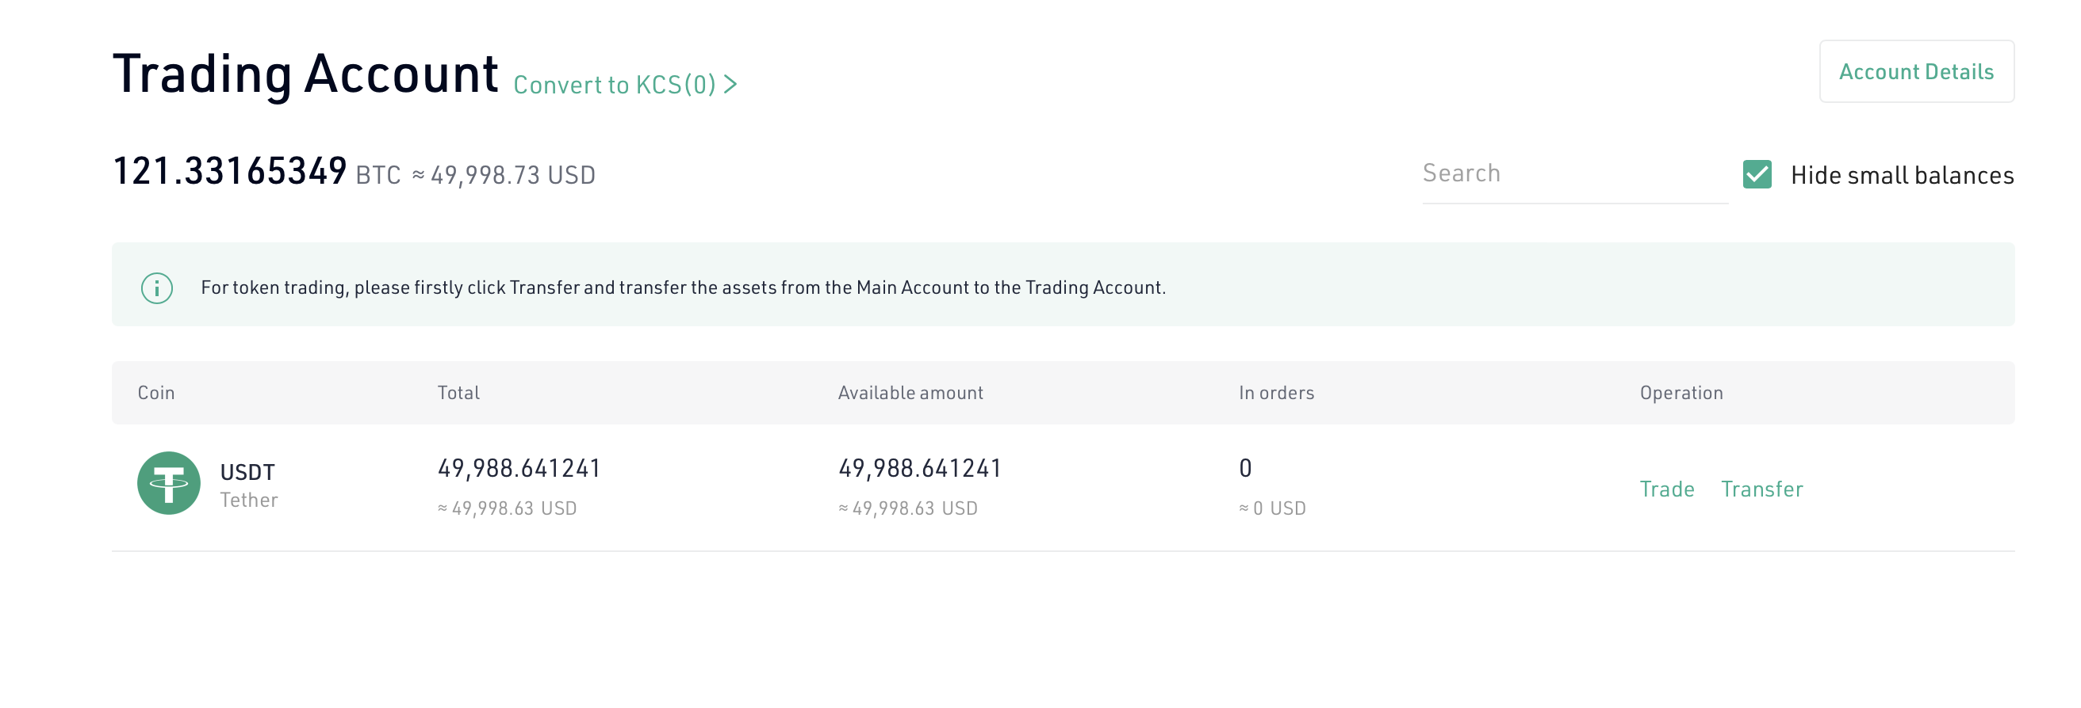
Kucoin
Sub Account with starting balance of 5000$

Slide 20
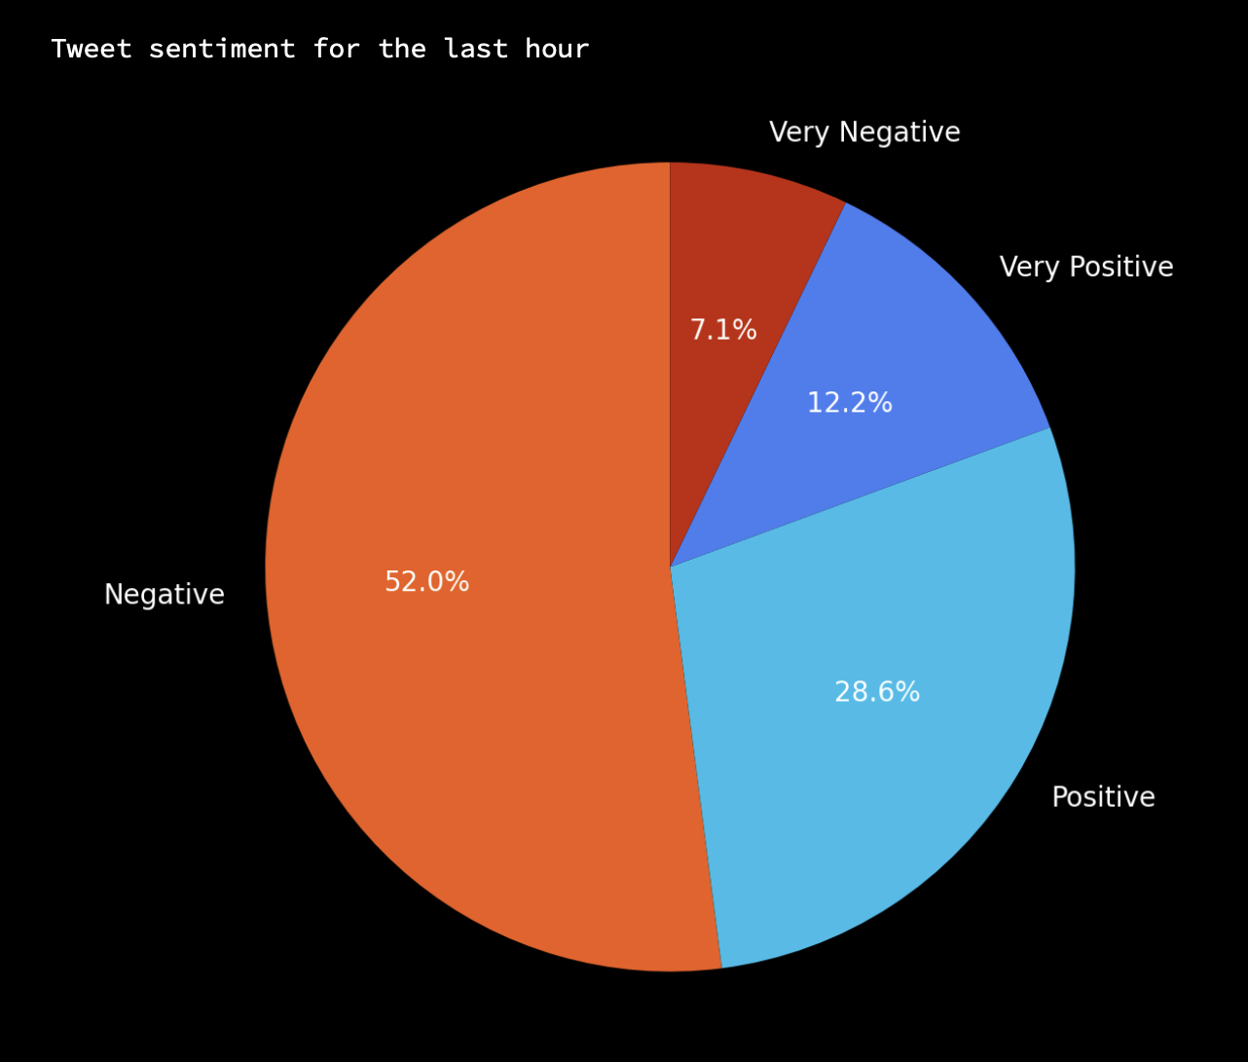
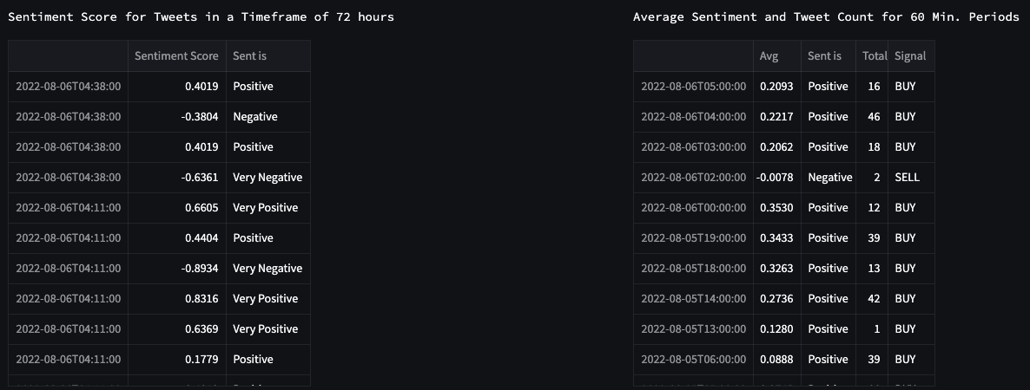
Strategy

Slide 21
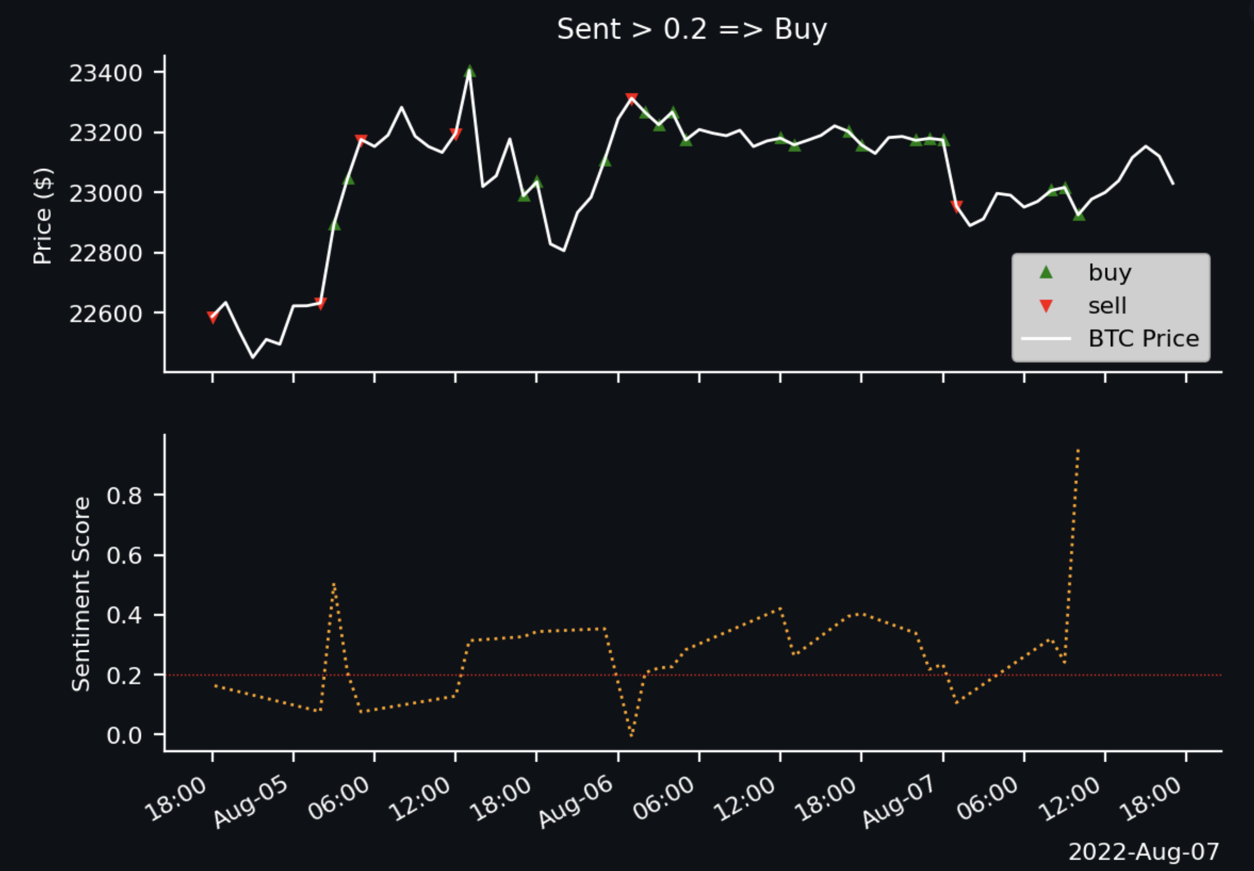
Heroku schedules trades
every hour

Slide 22
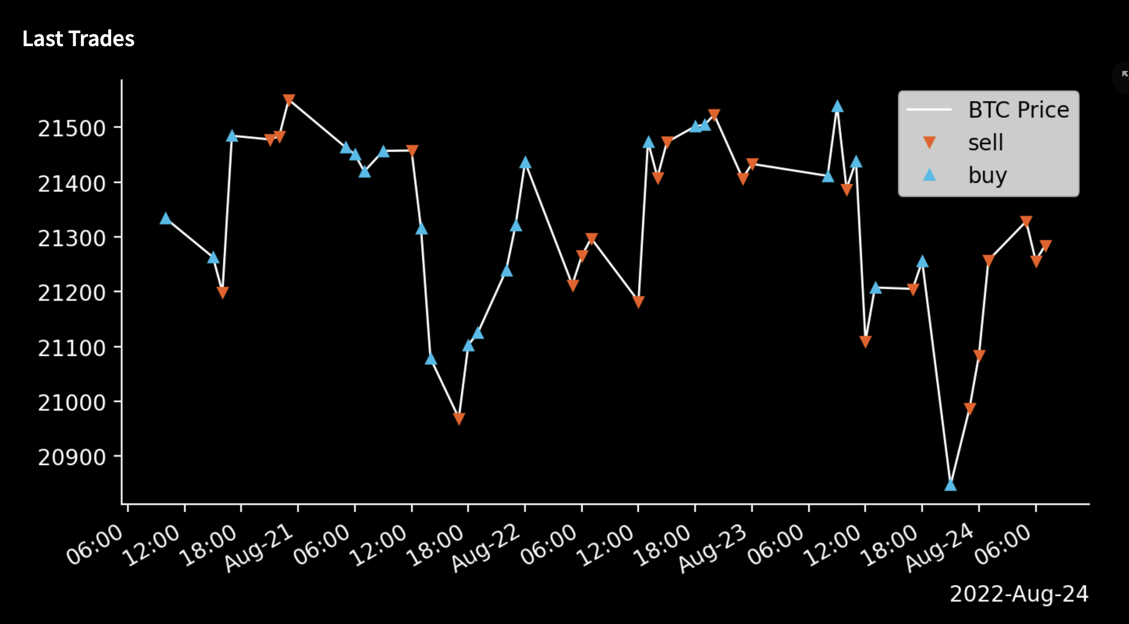

Slide 23
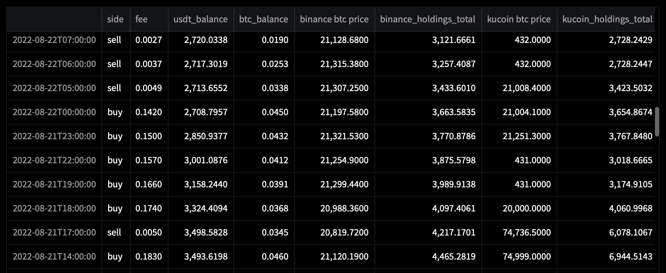
Incoherent Prices on Kucoin

Slide 24
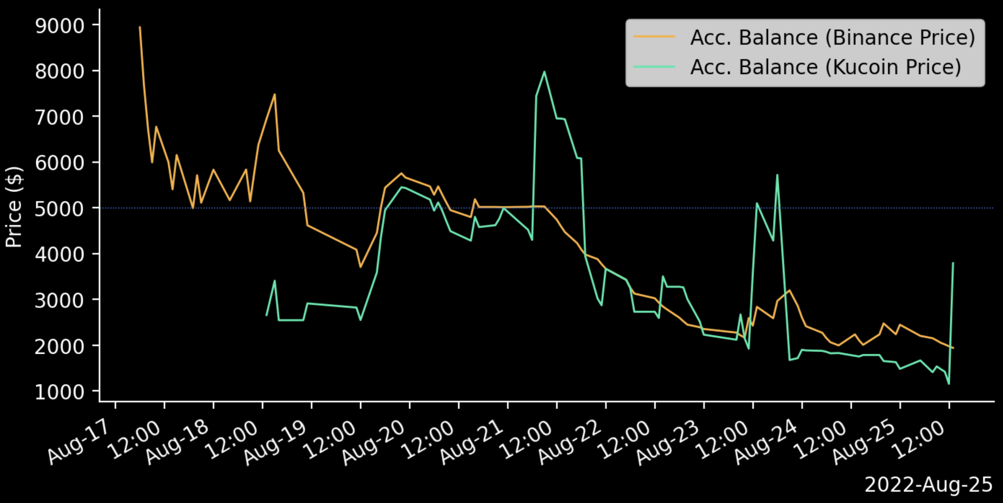
Results

Slide 25
Conclusion
All requirements were achieved to a full satisfaction of Yannik
The system does what it is supposed to do:
- listens and filters real-time tweets,
- builds signals from a calculated sentiment
- trades based on these signals
- runs in the background
- stores all important data inside a database
- visualises all insightful data on a website.

Slide 26
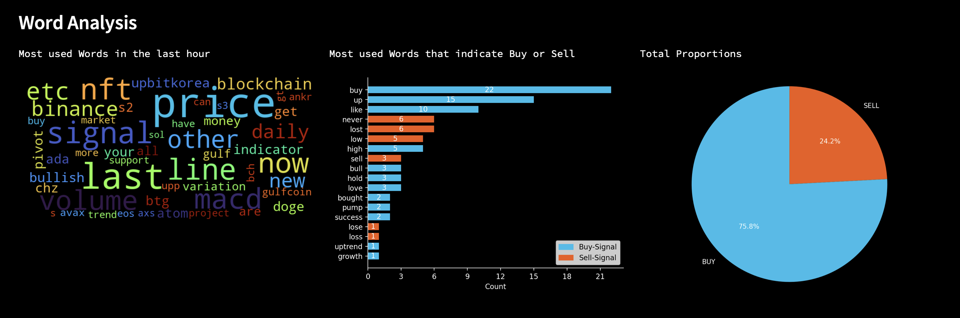
Outlook
Future strategies to implement:
Looking for single words for "bullish" or "bearish" sentiment
Using technical indicators like the 20-SMA (20 day single moving average) in combination with sentiment analysis
Calculating the weighted average instead of a normal average
Ratio of positive / negative sentiment crossing a particular threshold

